Slide 1

An Automated Annotation System for Document Text Images
GOKARAJU RANGARAJU INSTITUTE OF ENGINEERING AND TECHNOLOGY
Department of Computer Science and Engineering
MAJOR Project Phase-II Final Review
~Dr. Ashlin Deepa R N, Associate Professor
  Jhansi Lakshmi - 20241A0566
    B. Srija - 20241A0564
    Maria Jabeen - 20241A0593
    K. Kushi Reddy - 20241A0583

Slide 2
Abstract:
GOKARAJU RANGARAJU INSTITUTE OF ENGINEERING AND TECHNOLOGY
Department of Computer Science and Engineering
MAJOR Project Phase-II Final Review
Annotation is the practice of supplementing text with extra details or labels to offer context, enhance comprehension, or facilitate the refinement of Natural Language Processing (NLP) models. The project's core objective is to develop a robust system capable of annotating document text images with minimal human intervention. This entails outlining distinct regions within an image and then generating descriptive text that effectively encapsulates the characteristics of these outlined areas. While manual annotation is time-consuming and error-prone, automatic image annotation tools step in to address these challenges, boosting efficiency and reliability. A key focus lies in achieving word-level annotations for handwritten document images. The resultant system not only mitigates the time and resource demands of manual annotation but also enhances the reliability and accuracy of annotations. This project stands to contribute significantly to the advancement of NLP applications, particularly in scenarios involving handwritten document analysis and understanding.

Slide 3
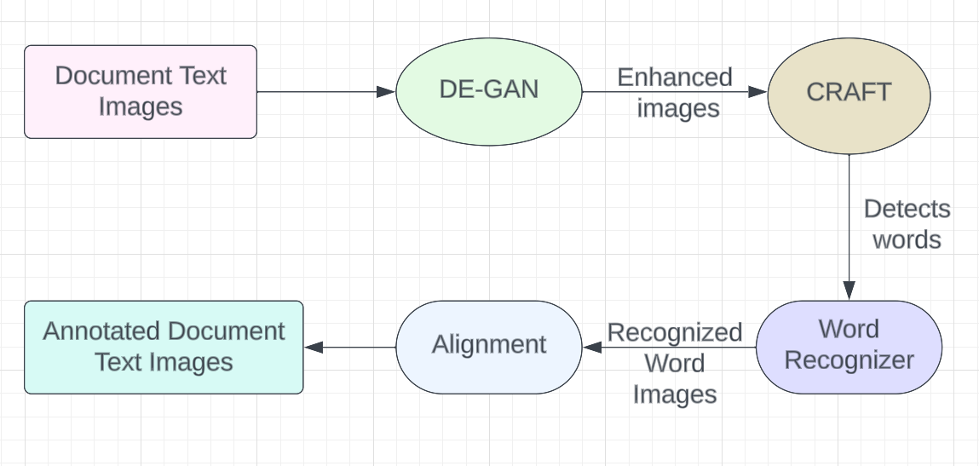
Fig 1: Architecture
GOKARAJU RANGARAJU INSTITUTE OF ENGINEERING AND TECHNOLOGY
Department of Computer Science and Engineering
MAJOR Project Phase-II Final Review
Architecture:

Slide 4
Recognition Model:
OCR is an text recognition model that combines Convolutional Recurrent Neural Networks (CRNN) to accurately recognize text from images.
Components:
Convolutional Layers:
  Utilizes residual blocks with convolutional layers, batch normalization, and ReLU activation.
  Incorporates max-pooling layers for efficient down-sampling.
STN (Spatial Transformer Network):
  Seamlessly integrated into residual blocks to execute affine transformations, enhancing recognition accuracy.
Recurrent Layers (Bi-LSTM):
  Employs two bidirectional LSTM layers fortified with dropout to capture sequence dependencies effectively.
Results:
Word Recognition Accuracy: 86.92%
Character Recognition Accuracy: 97.37%
GOKARAJU RANGARAJU INSTITUTE OF ENGINEERING AND TECHNOLOGY
Department of Computer Science and Engineering
MAJOR Project Phase-II Final Review
Result Analysis:

Slide 5
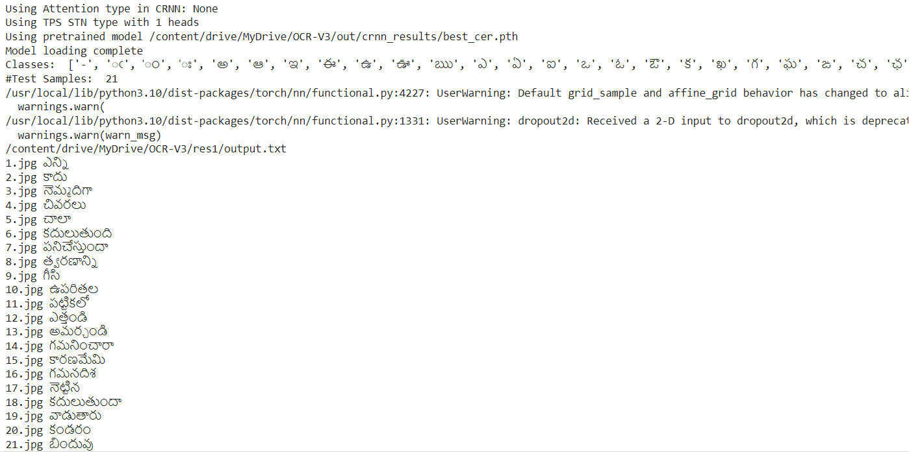
Fig 2: Prediction Result
GOKARAJU RANGARAJU INSTITUTE OF ENGINEERING AND TECHNOLOGY
Department of Computer Science and Engineering
MAJOR Project Phase-II Final Review
Result Analysis:

Slide 6
OCR Post-Correction Model:
The OCR Post-Correction Model corrects errors in Optical Character Recognition (OCR) outputs using an LSTM-based sequence-to-sequence framework with attention.
Key Components:
Encoders:
  Character-level bidirectional LSTMs transform input characters into hidden state vectors for both the original text and its translation.
Attention Mechanism:
  Computes attention weights over encoder hidden states.
  Produces context vectors for decoding by weighting encoder states.
Results:
CER: 0.0644
WER: 0.2650
GOKARAJU RANGARAJU INSTITUTE OF ENGINEERING AND TECHNOLOGY
Department of Computer Science and Engineering
MAJOR Project Phase-II Final Review
Result Analysis:

Slide 7
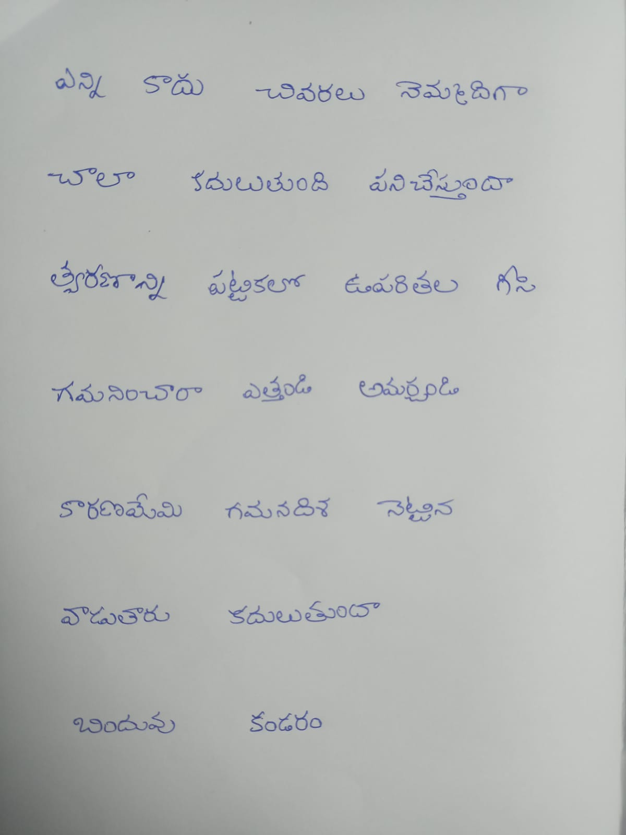
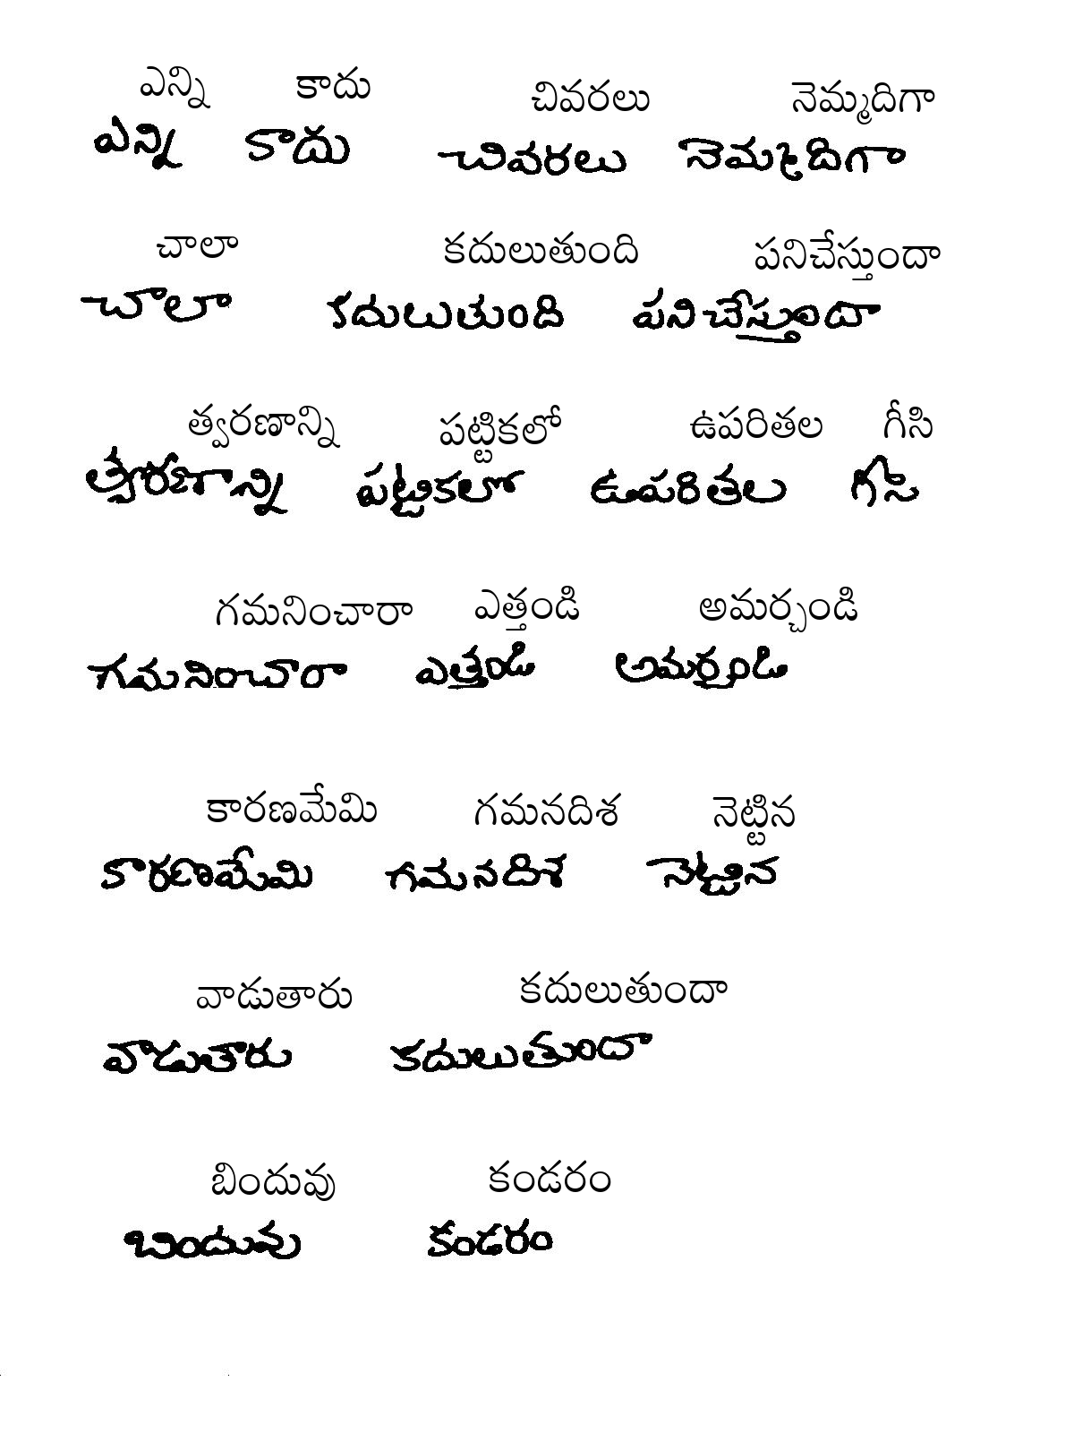
GOKARAJU RANGARAJU INSTITUTE OF ENGINEERING AND TECHNOLOGY
Department of Computer Science and Engineering
MAJOR Project Phase-II Final Review
Result Analysis:
ID | Test Data | Output
1

Slide 8
GOKARAJU RANGARAJU INSTITUTE OF ENGINEERING AND TECHNOLOGY
Department of Computer Science and Engineering
MAJOR Project Phase-II Final Review
Publication status of Review Paper:
We have submitted a major project phase-1 review paper titled “ A review on Automated Annotation System for Document Text Images” at the 2024 International Conference on Cognitive, Green, and Ubiquitous Computing (IC-CGU) and the paper got accepted.
The proof of submission and acceptance are in the following slides:

Slide 9
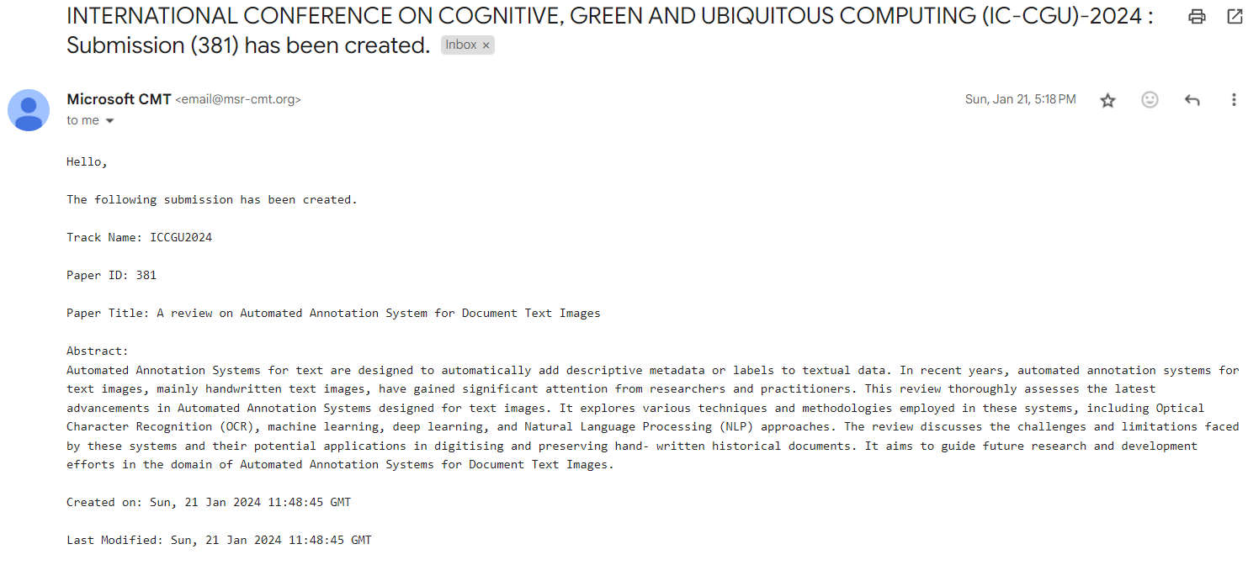
GOKARAJU RANGARAJU INSTITUTE OF ENGINEERING AND TECHNOLOGY
Department of Computer Science and Engineering
MAJOR Project Phase-II Final Review
Publication status of Review Paper:
Fig 3: Review Paper Submission

Slide 10
GOKARAJU RANGARAJU INSTITUTE OF ENGINEERING AND TECHNOLOGY
Department of Computer Science and Engineering
MAJOR Project Phase-II Final Review
Conclusion :
In conclusion, an Automated Annotation System designed for document text images brings transformative benefits to various industries. By leveraging advanced image processing techniques, such as Optical Character Recognition (OCR) and deep learning algorithms, this system significantly enhances document analysis, data extraction, and information retrieval processes. It optimizes efficiency, accuracy, and productivity by automating the time-consuming task of manual annotation. This system finds applications in areas ranging from digitizing historical archives and cataloging large document databases to aiding in content indexing and semantic understanding. As technology continues to advance, the development and adoption of Automated Annotation Systems for Document Text Images hold the promise of revolutionizing the way we interact with and extract knowledge from textual documents.

Slide 11
GOKARAJU RANGARAJU INSTITUTE OF ENGINEERING AND TECHNOLOGY
Department of Computer Science and Engineering
MAJOR Project Phase-II Final Review
Snapshots:
Fig 4: Annotated image

Slide 12
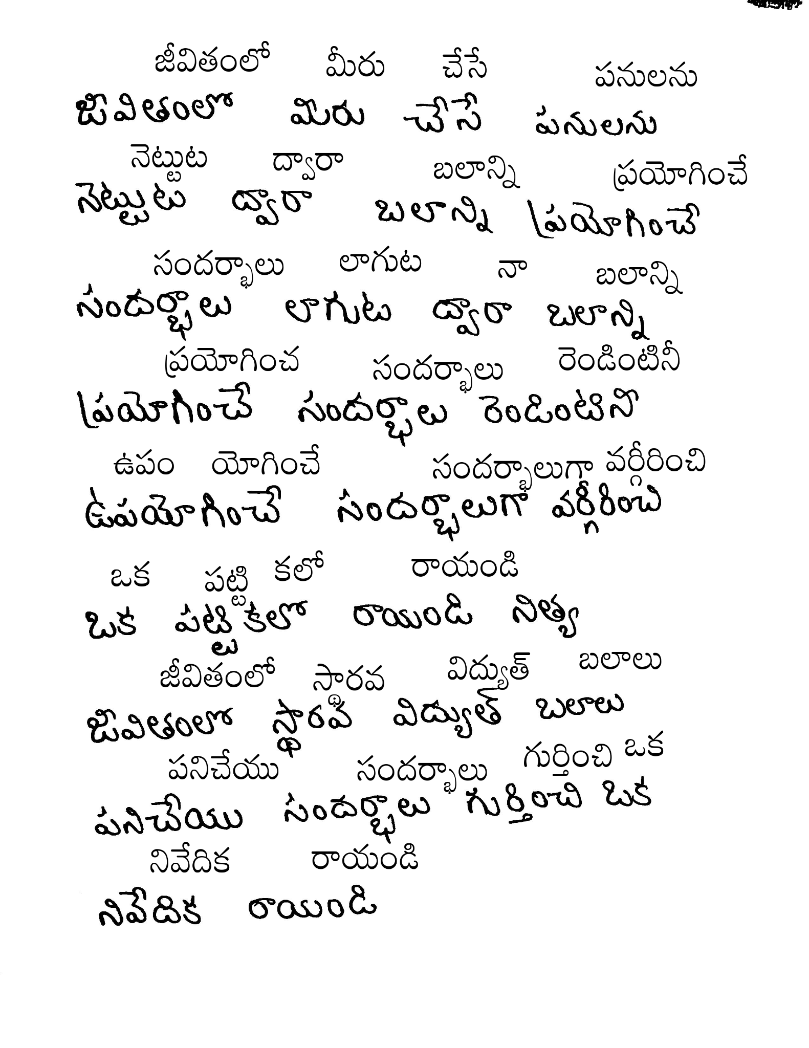
GOKARAJU RANGARAJU INSTITUTE OF ENGINEERING AND TECHNOLOGY
Department of Computer Science and Engineering
MAJOR Project Phase-II Final Review
Snapshots:
Fig 5: Annotated Image

Slide 13
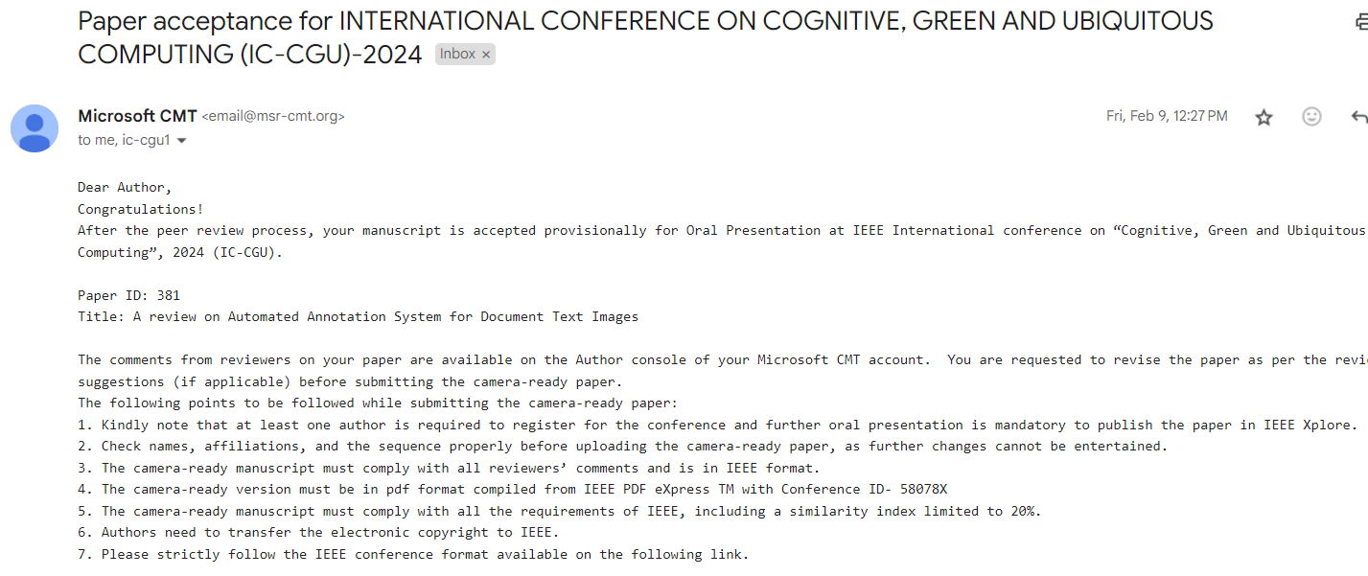
GOKARAJU RANGARAJU INSTITUTE OF ENGINEERING AND TECHNOLOGY
Department of Computer Science and Engineering
MAJOR Project Phase-II Final Review
Proof for Publication :
Fig 6: Paper Acceptance for Review paper

Slide 14
THANK YOU & QUERY
GOKARAJU RANGARAJU INSTITUTE OF ENGINEERING AND TECHNOLOGY
Department of Computer Science and Engineering
MAJOR Project Phase-II Final Review

